Slide 1
Natural Language Processing
Unit 12 Classification & Semantic Matching
Faizan Javed
DataScience @ SMU

Slide 2
Supervised Learning
Requires training examples with labels
A learning algorithm that classifies new observations to one or more classes
Regression: predicting a continuous value (e.g., predicting house prices) Credit scoring or predicting house prices
Classification: predicting a label (e.g., predicting the category of an item on an ecommerce site, “Samsung 7.5 cu. Ft. Electric Dryer in White” → ”Laundry Care | Dryers”
E,.g., Is this a hammer or a light bulb?

Slide 3
Classification
Categorize documents into one (or more) classes or topics
Industrial-scale: classify millions of items into thousands of categories

Slide 4
Classification
Binary classification (two classes), e.g., spam classification
Multi-class classification (multiple classes, mutually exclusive), e.g., ecommerce product categorization
Multi-label classification: assigning multiple classes to an observation, e.g., Google Images: object classification in an image

Slide 5
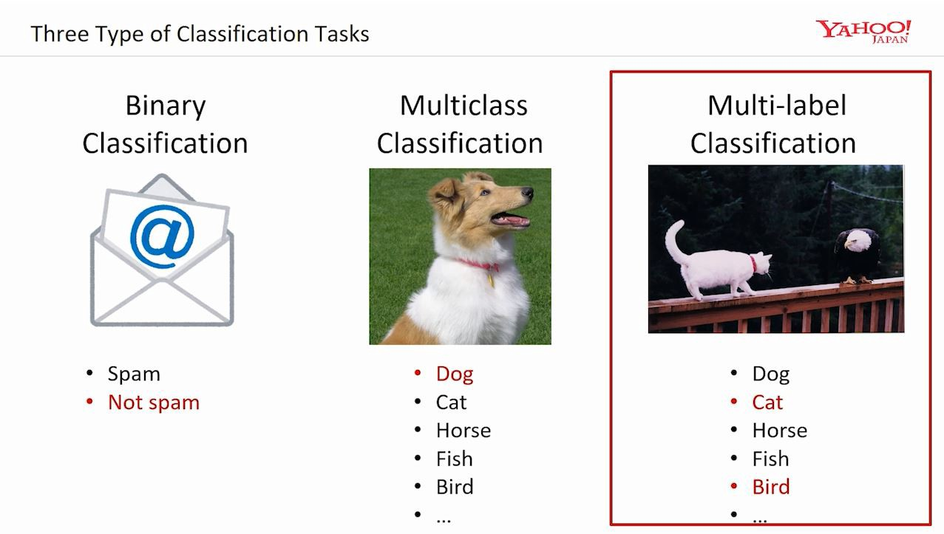

Slide 6
Naïve Bayes - Bayes Law
Given two events x and y
P(x), P(y) = probabilities for event x and y
P(x,y) = joint probabilities (both events happen)
P(x|y) = conditional probability (event x happens given that y happens)
Bayes Law: p(y|x) = (p(x|y) p(y)) / p(x)
P(spam|word) = ( p(word|spam) p(spam)) / p(word). Note: these are counts
Non-spam aka “Ham” is 1 – p(spam) {p(spam) = all spam emails}

Slide 7
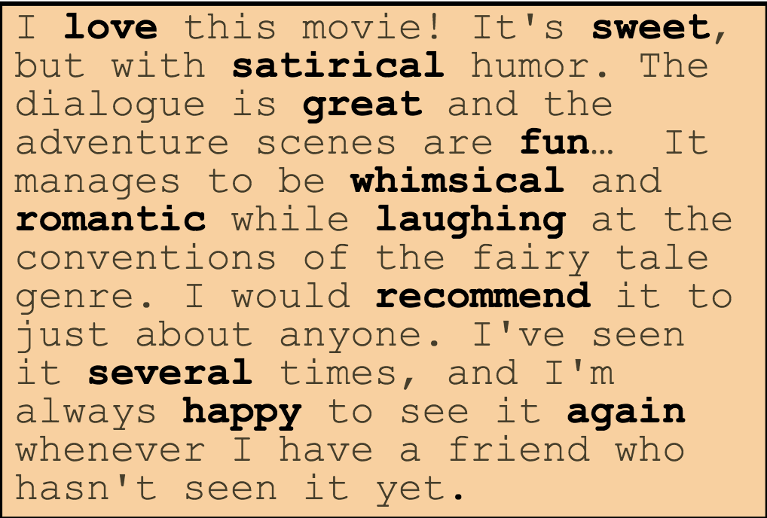
Naïve Bayes properties
Document representation: Bag of Words
E.g., a word vector for every email and word counts
Conditional independence: feature probabilities are independent for a given class (i.e., word co-occurrence is not taken into account)
Robust to noisy features and concept drift (e.g., US President)
Good efficient performance – often used as a baseline classifier

Slide 8
Chimera: Large-Scale Classification Using Machine Learning, Rules, and Crowdsourcing https://blog.acolyer.org/2016/01/28/chimera/
Classify tens of millions of product descriptions into 5000+ product types (e.g., “area rugs”, “rings”, “laptop bags & cases”)
New products turn up all the time and categories are evolving; distribution of items is not static and there is concept drift (e.g “computer cables” keeps getting new types of cables)
Uses both learning and hand-crafted rules (written by domain analysts) extensively.
Uses a combination of crowdsourcing and in-house analysts to evaluate and analyze the system, to achieve an accurate, continuously improving, and cost-effective solution for classification.

Slide 9
Problem scenario and analysis
Training data for 5000+ product types
Limited number of in-house analysts for creating training data
Fast classification response time
High precision, 92%: use case: the product type of an item to determine the “shelf” on walmart.com on which to put the item, so that users can easily find this item by navigating the item pages on walmart.com
Low recall is ok because because items that cant yet be classified are sent to a team that manually classifies as many items as possible, starting with those in product segments judged to be of high value for e-commerce.

Slide 10
Problem scenario and analysis
Manual labeling can be hard: e.g., .
“Misses’ Jacket, Pants And Blouse - 14 - 16 - 18 - 20 - 22 Pattern” has the product type “sewing patterns”
Outsourcing/crowdsourcing: can be expensive, not easy to scale up, or have quality control issues.
Difficult to generate representative examples: Skewness: e.g, more than 40% of items are from “Home & Garden” → lots of “area rugs” and “stools”,
“computer cables”, can include a variety of cables, such as USB cables, networking cords, monitor cables etc.. Need to do an extensive search to find all subtypes.
Corner cases: limited number of trial items or a new Vendor; hard to generalize the “last mile” in machine learning

Slide 11
Classify incoming products, then use crowdsourcing to continuously evaluate the results and flag cases judged incorrect by the crowd.
Analysts examine flagged cases, and fix them by writing new rules, relabeling certain items, and alerting developers.
The newly created rules and the relabeled items are incorporated into the system, and the developers fine tune the underlying classification algorithm.
For those items that the system refuses to classify (due to a lack of confidence), the analysts examine them, then create hand-crafted rules as well as training data (i.e., labeled items) to target those cases. The newly created rules and training data are incorporated into the system, and it is run again over the product items.

Slide 12
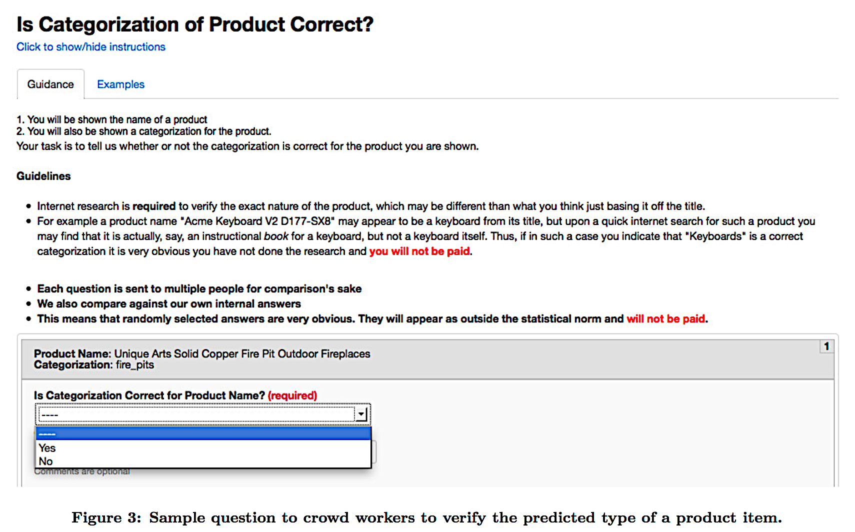

Slide 13
Gatekeeper: if theres an exact match, send to results processing, else send to three different classification systems in parallel
Rules-based system (white and black list regexs): “wedding bands? → rings”, “key chain? → NOT rings”.
Attribute and value-based classifier, e.g, if a product has an attribute “ISBN”, classify it as ”books”
Machine learning ensemble: Naïve bayes, KNN, Perceptron
Voting master: applied majority voting or weighted voting to results. Apply a final rule-based filter (e.g., some non-food items were being classified as “pizza”, added a filter for ”pizza”)

Slide 14
Continuous evaluation:
To detect cases where the output is not sufficiently accurate, so that the analysts and developers can improve those,
To ensure that the results we send to downstream applications are accurate.
To detect accuracy deterioration: accurate cases that stop being so due to a change in the incoming data, the underlying algorithm, or the crowd.

Slide 15
Lessons Learned
Things break down at large scale
Both learning and hand-crafted rules are critical
Crowdsourcing is critical, but must be closely monitored
Crowdsourcing must be coupled with in-house analysts and developers
Outsourcing does not work at a very large scale
Hybrid human-machine systems are here to stay

Slide 16
Product Title Classification versus Text Classification https://www.csie.ntu.edu.tw/~cjlin/papers/title.pdf
A variant of Short text classification
Different from full texts in several aspects:
length of each instance (most titles are very short),
distribution of lengths (most product titles have similar lengths),
grammatical structure (most titles are incomplete sentences).
Should we apply the standard NLP pre-processing pipeline to short-text?
stemming, stop-word removal, feature-vectors, bigram / trigram feature transformations et al?

Slide 17

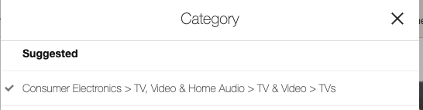
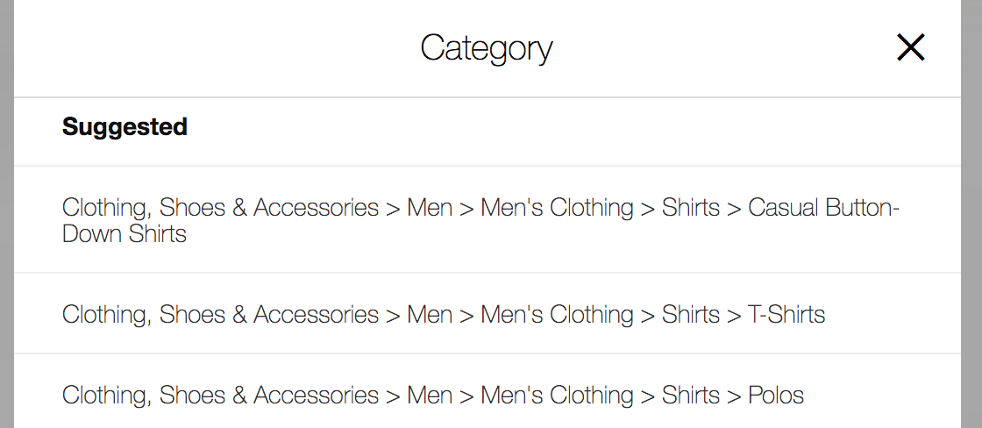
Ebay seller examples
“Sony 4k tv”
“Ralph Lauren Polo black shirt”

Slide 18
Baseline:
Conversion of all words into lower case.
Simple tokenization by splitting titles on spaces, punctuations and number/alphabet transitions.
For example, “aa:bb 70d” becomes four tokens
“aa,” “bb,” “70,” and “d.”
No stemming; no stop-word removal.
Binary unigram as feature values.
One-versus-rest multi-class SVM for classification. (using the LIBLINEAR package)

Slide 19
Observations for product title classification
Stemming and stop-word removal should not be applied (stemming more harmful than stop-word removal)
“sony cd radio cassette recorder” → consumer electronics (baseline)
“sony cd radio cassette record” → music (SVM)
“barbie all dolled up birthday party jointed banner” → home & garden (baseline)
“barbie all doll up birthday party jointed banner” → dolls & bears (SVM)
Because words in a title are generally unique, binary and TF-IDF representations perform the same.
Bigrams and degree-2 polynomial mappings features are beneficial for product title classification

Slide 20
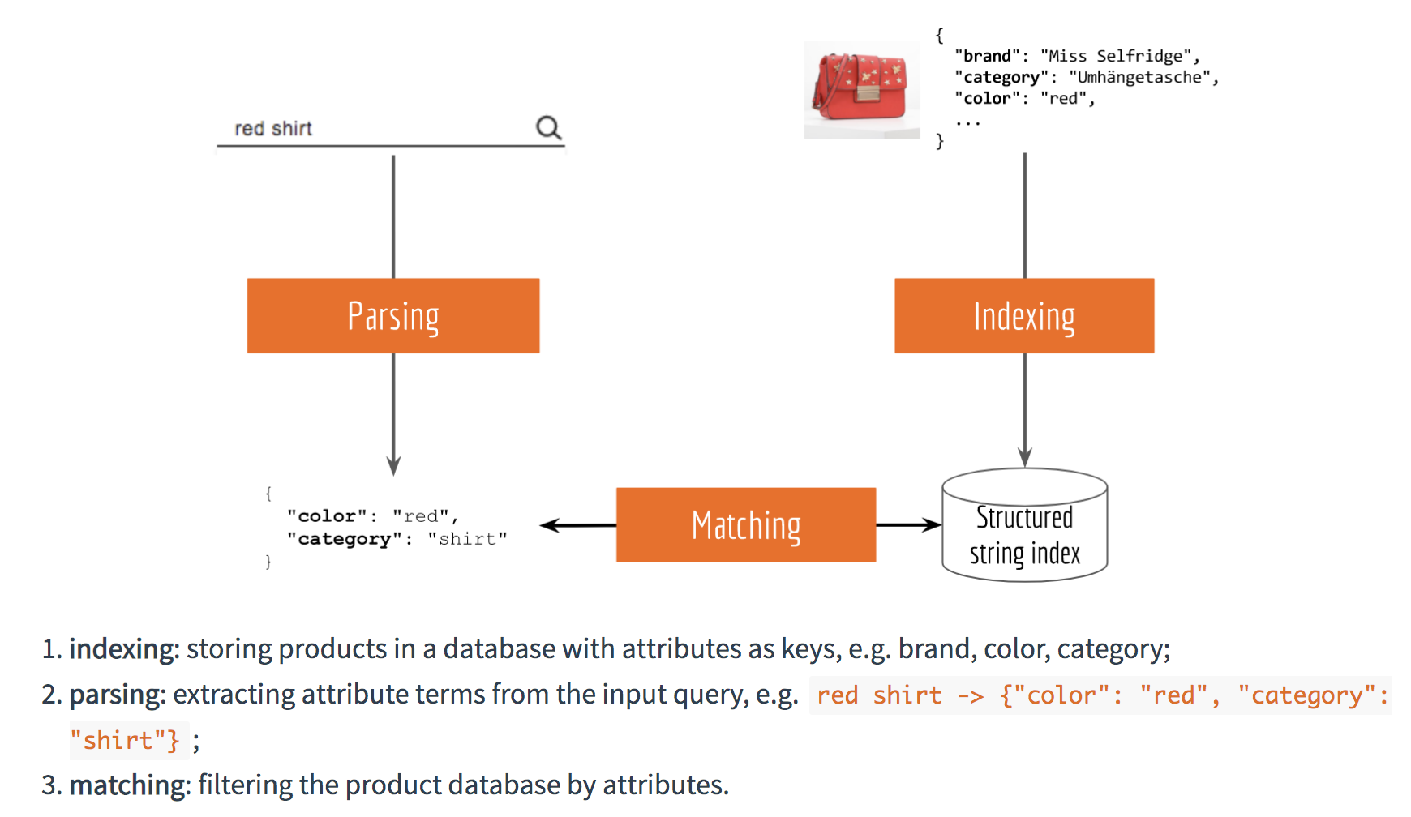
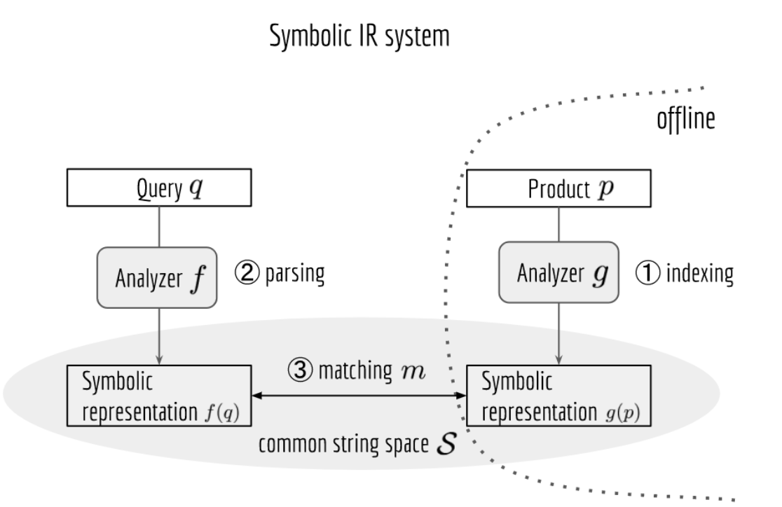
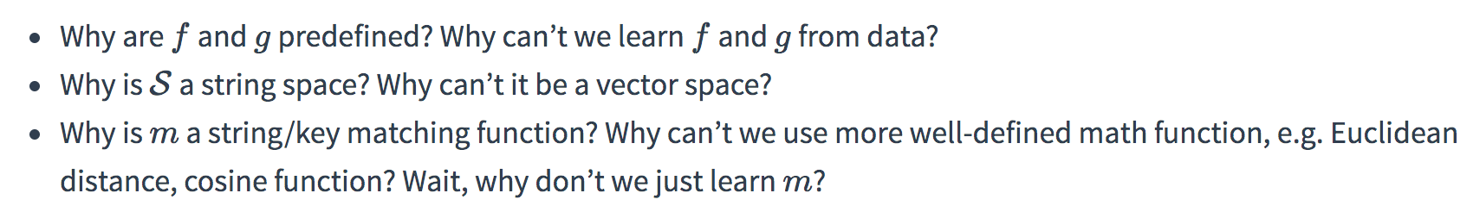
Symbolic vs Neural approaches for Product Search https://hanxiao.io/2018/01/10/Build-Cross-Lingual-End-to-End-Product-Search-using-Tensorflow/
Product search:
Understand user’s query in any language,
Retrieve relevant results and present them as a list,
Most relevant results should be on top of the list
Symbolic NLP based approach:

Slide 21
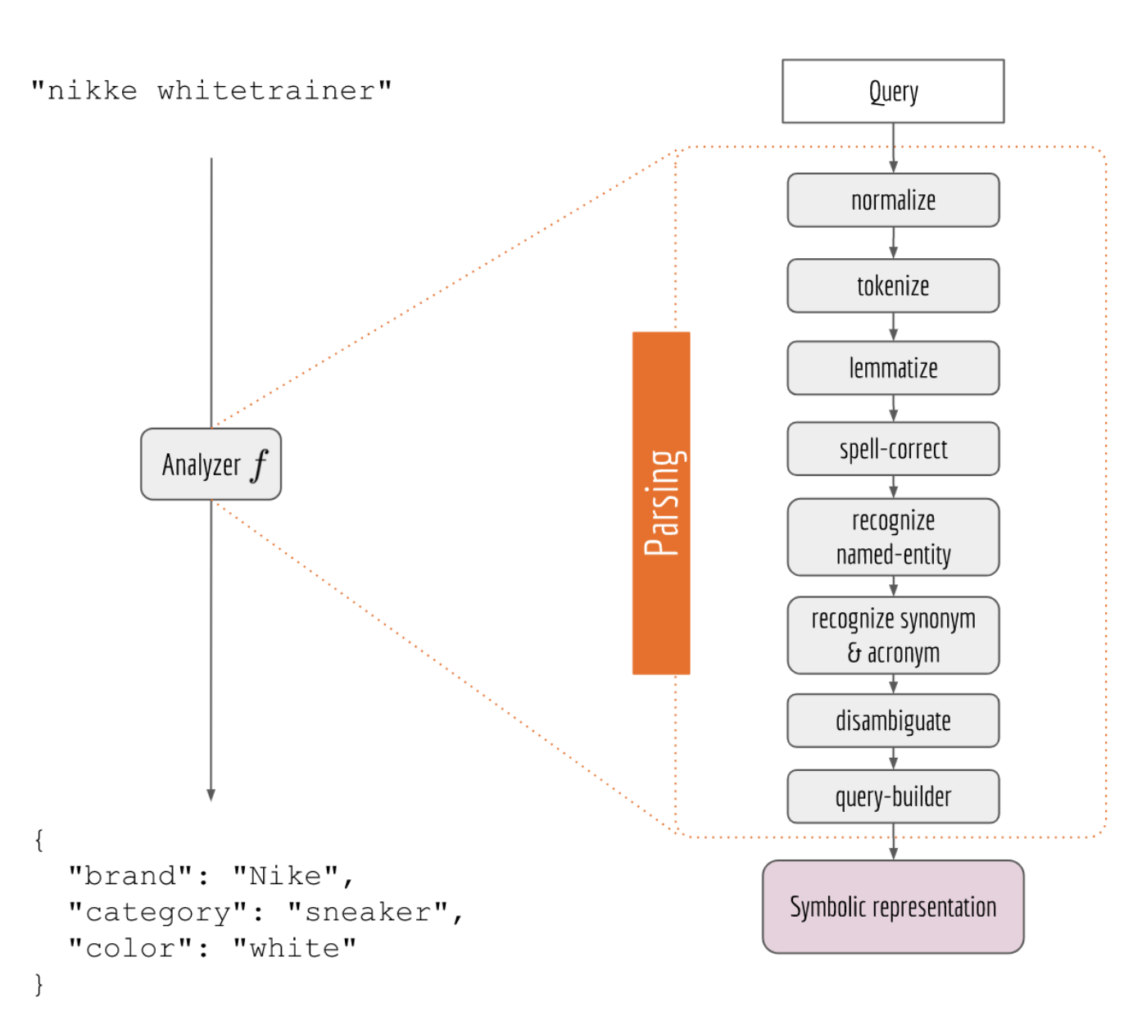
The NLP pipeline is fragile
Components have dependencies - a deficiency can ripple across downstream components
Complex dependencies – a component can take from and out to multiple comonents. This can increase blocking/processing time
An improvement in one or two components may not necessarily improve overall search quality
Doesn’t scale out to multiple languages – may have to implement language dependent components in multiple languages
Doesn’t understand semantics without hardcoding; e,g., need to define a synonym rule to associate trainer with sneaker instead of learning from similarity in vector spaces

Slide 22
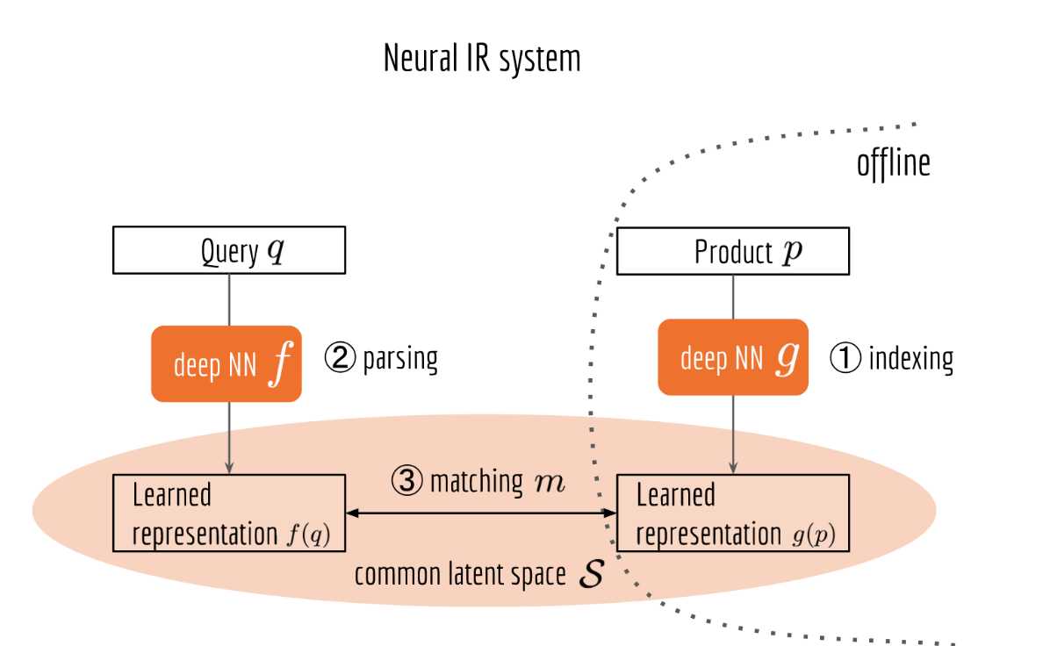
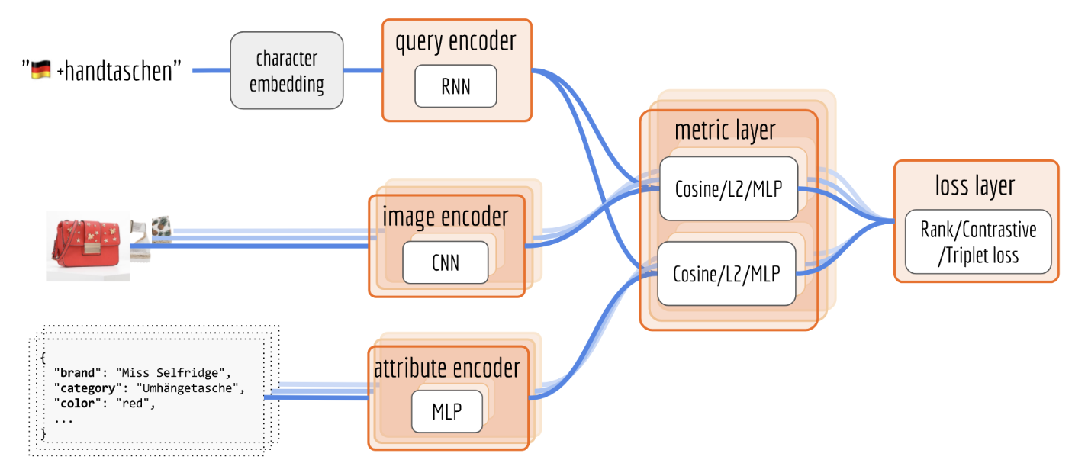
Neural Information Retrieval (IR) system
f is query encoder, g is product encoder
Query encoder: takes in a sequence, output a vector. A character-RNN model is a good choice because its resilient to spelling mistakes.
Image encoder: visual information. RGB image data is fed into a CNN based on ResNet architecture.
Attribute encoder: combine attributes into a 1-hot encoded vector and a DNN
Why do we need both image and attribute encoders? Consider the queries:
nike red shoes vs tshirt logo on back
Metrics and loss layer:computes similarities between vectors and measures the loss function

Slide 23
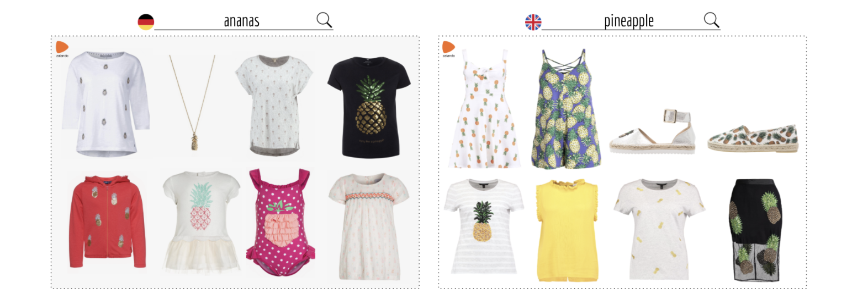
Where to get the query-product training data?
System logs contain what products a user interacted with (click, add to wishlist, purchase) after typing a query. Other good user-generated association data: product reviews, comments, etc.
Example of what German and British users clicked on Zalando.com after searching for ananas and pineapple respectively:

Slide 24
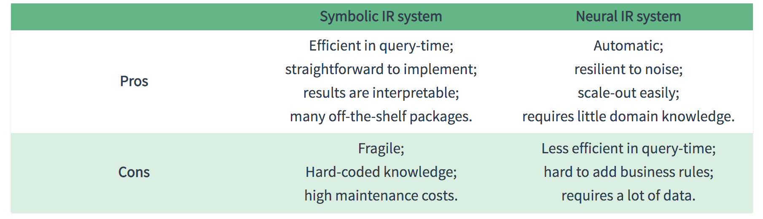
Symbolic NLP vs Neural IR system

Slide 25
What did you learn today?
Questions?

